Slide 1


CAO & Further Education Information
Leaving Cert 2021
Parents and Students
Sally Gibbs
Guidance Counsellor

Slide 2
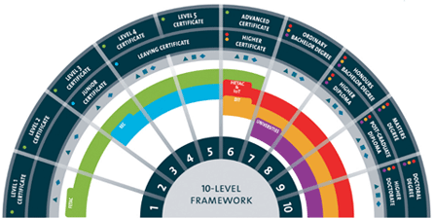
Quality & Qualifications Ireland (QQI)
Level 5 Certificate – 1 year
Level 6 Higher Certificate - 2years
Level 7 Ordinary Bachelor Degree – 3 years
Level 8 Honours Bachelor Degree – 4 years (mostly!)

Slide 3
The Ladder System
Universities
Institutes of Technology
FETAC
Teagasc, Post-Leaving Cert Course
Leaving Certificate

Slide 4
CAO Dates & Fees
ONLINE APPLICATION FEE CLOSING DATE
Discounted Rate €30 20th Jan 2021
Normal Application €45 1st Feb 20201
Late Application €60 5th May 20201
(restricted courses cannot be applied for at this time)

Slide 5
CAO is currently open
Don’t leave it until the last minute to apply...
Christmas holidays is a good time
Demo and Mock CAO’s are have been completed!

Slide 6
Stages of the CAO Application
Stage 1: Before Applying (Research, Goal Setting)
Stage 2: Completing the Application
(currently open www.cao.ie)
Stage 3: Statement of Application from CAO (before end of May)
Stage 4: Change of Mind (5th May- until 1st July 2021)
Stage 5: Leaving Certificate Results
(expected mid August…)
Stage 6: Offers and Acceptance of Places
(expected online 2 days after LC results)

Slide 7
Stage 1
Before you apply

Slide 8
Stage 1
How to ensure you make a wise application...
Research and Shortlist CAO Courses
DISCUSS options with the Guidance Counsellor, Parents, Teachers, College Admissions, siblings/friends
Gather information on courses
e.g. modules you will be studying each year,
Erasmus options, work experience etc

Slide 9
Check the Specific Course Requirements
Become familiar with the CAO Handbook
Most of all…be aware of your priorities- location/ qualification etc
THINK about what it is you’d like/ prefer to study for the next few years

Slide 10
Research is the students responsibility
  www.cao.ie
  www.qualifax.ie
  www.careersportal.ie
  www.accesscollege.ie
  www.studentfinance.ie
  www.susi.ie

Slide 11

Stage 2
Completing an Application

Slide 12
Two Applications in One Form
There are two course choice lists and applicants may make up to ten course choices on each list.
10 choices may be made on the Level 8 list
10 choices may be made on the Level 7/6 list
The choices on one list do not affect your choices on the other list

Slide 13
It is possible to receive an offer on both lists
A decision must be made (in August) to accept either the Level 7/6 or the Level 8 offer
Alternatively, neither offer may be accepted...or you can defer a choice for a year/ reapply

Slide 14
Order of Preference
If you learn nothing else from this presentation let it be this...
Place your course choices in genuine ‘Order of Preference’

Slide 15
So, what’s the best way to fill out your CAO form?
Level 8 (Honours Degrees - > Universities & I.T.’s) | Level 6 / 7 (Higher Certificates / Ordinary Degrees -> I.T.’s )
1 2 DREAM COURSES 3 4 5 6 REALITY 7 8 9 BACK-UP 10 | 1 2 3 4 5 6 7 8 9 10
As points are lower for these courses, many students get 1st or 2nd choices

Slide 16
Application Number
When you apply online your application number will appear on the Receipt of Online Application
This number is private and it will be used in every correspondence between you and the CAO for the rest of the year- keep it safe!
When you apply online- you may change your course choices free of charge until 1st February 2021 @ 5:15pm

Slide 17

Stage 3
Statement of Application from CAO

Slide 18
The Statement of Application is important for two reasons:
The statement lists the courses that you have applied for...
...It also details your personal information
If there is any mistake / omission in the list of course choices or your personal info then you must contact CAO to correct the error ASAP

Slide 19
Communicating with CAO
The easiest and most efficient way to communicate with CAO is by using the 'Contact Us' facility on the CAO website.
Always quote your CAO application number in any communication with CAO.
If posting something to CAO, always get the Certificate of Posting stamped on back of the CAO handbook. This offers peace of mind.

Slide 20
Stage 4
Change of Mind

Slide 21
Change of Mind
  The Change of Mind facility may be used to change the order of course choices and/or to introduce new courses, subject to the restrictions detailed in the Handbook
  The Change of Mind Facility is ONLY available online
  The facility opens from 5th May - 1st July 2021

Slide 22

Stage 5
THE RESULTS!!!

Slide 23
The Points System
Only applies to CAO Courses
Top 6 LC subjects counted for points (5 for many Level 6/7’s)
25 bonus points for HL Maths (only applies if it’s one of your top 6)
LCVP – can be used as 1 of the 6 subjects:
Distinction 66 points
Merit 46 points
Pass 28 points

Slide 24
Leaving Certificate Points
Higher Level Grade | CAO Points | Ordinary Level Grade | CAO Points
H1 | 100
H2 | 88
H3 | 77
H4 | 66
H5 | 56 | O1 | 56
H6 | 46 | O2 | 46
H7 | 37 | O3 | 37
H8 | 0 | O4 | 28
 |  | O5 | 20
 |  | O6 | 12
 |  | O7 | 0
 |  | O8 | 0

Slide 25
Calculating Points
Subject | Level | Grade | Points
English | H | H6 | 46
(Irish | O | O3 | 37)
Maths | H | H6 | 46 + 25
History | H | H3 | 77
German | H | H2 | 88
Chemistry | H | H5 | 56
Business | H | H3 | 77_
 |  | Total | 415
LCVP | C | D | 66__
Replace English with LCVP= New Total |  | New Total | 435

Slide 26
Stage 6
Offer and Acceptance of Places

Slide 27
The Offer Process
The Friday (usually?!) following the release of the Leaving Certificate results, CAO will either:
Send notice of a Level 6/7 AND/OR Level 8 Offer
or
If you have not yet become entitled to an offer you will be sent a Statement of Application Record which you should check carefully to make sure all information on it is correct
Offers will also be available on the CAO website...
...You may check for and accept offers on the website...most students use this option nowadays.

Slide 28
The offer notice may contain an offer
  for a Level 8 course
  or a Level 7/6 course
  or both
If two offers are received at the same time you may only accept one of them.
If you wish to accept an offer of a place you must carry out the instructions on the offer notice before 5.15pm on the closing date for acceptance printed on the offer notice.

Slide 29
There can be no delays at the offer/acceptance stage.
Any offer not accepted by the closing date for receipt of acceptance of offers in CAO will be offered to another applicant in the next round of offers.

Slide 30
Allocation of Places
We will look just at Level 8 courses, but exactly the same process will take place with Level 7/6 courses, and at the same time.
The importance of the applicant placing courses in genuine order of preference will become apparent in the following slides.

Slide 31
When examination results are released in August they are entered into the CAO computer.
The computer checks each applicant’s results. For each course the applicant has applied for, the computer first determines if the applicant has the minimum entry requirements for the course....eg H5 Irish/ O3 Maths etc
If the applicant meets the minimum entry requirements for the course, the applicant’s points are calculated for this course choice.

Slide 32
All eligible applicants are then placed in a list, in order of academic merit, for each course that they applied for.
The admissions officers of the Higher Education Institutions (HEI’s) tell CAO how many places are to be offered on each course
CAO then makes offers to the required number of applicants on each course starting with the applicant with the highest points and working down until enough places have been offered.

Slide 33
Should some applicants decline their offers these places become available in the next round of offers. They will be offered to the next applicants on the order of merit list.
This process continues until all the places on the course are filled or until all the eligible applicants on the order of merit list have been offered places.

Slide 34
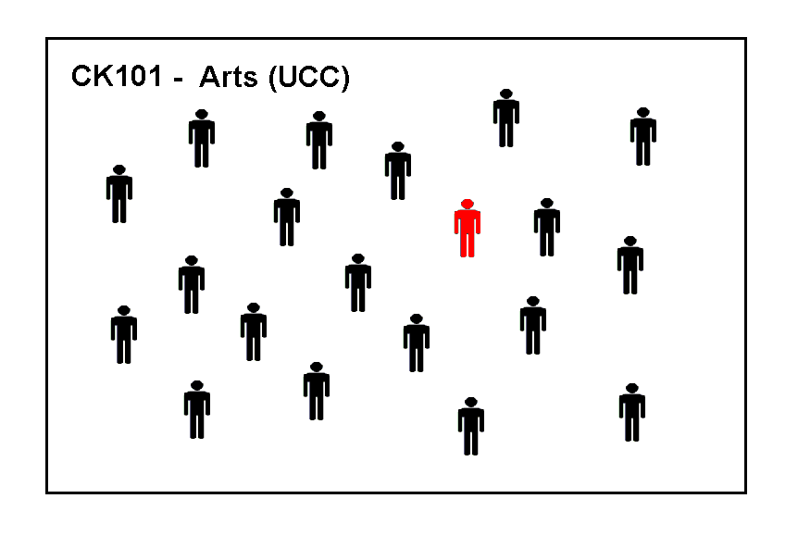
These are the applicants for CK101 Arts in UCC.
The examination results have not yet been released, so these applicants are in no particular order. We are going to trace the progress of the applicant marked in red.

Slide 35
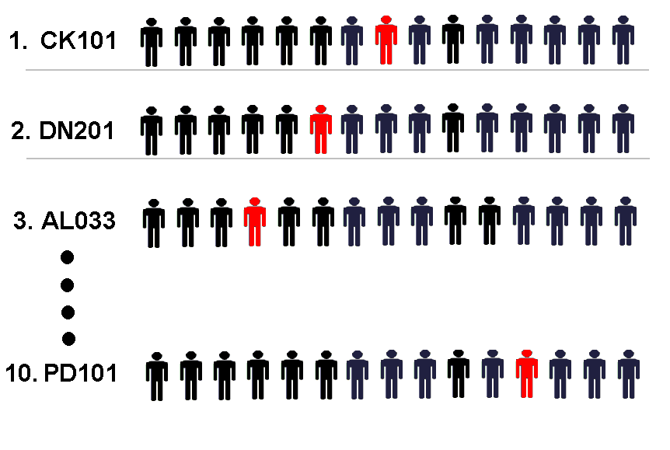
Applicants are placed in a queue for each course they applied for, their position in the queue is determined by their points. The applicant with the highest points is placed at the top of the queue. The points achieved by the applicant in red determines her position in the queue for each course she applied to.

Slide 36
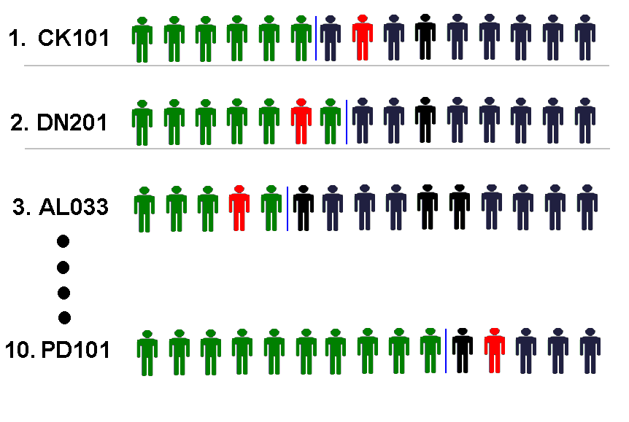
The applicants marked in green have enough points to be offered places.
The applicant marked in red has enough points for her second preference

Slide 37
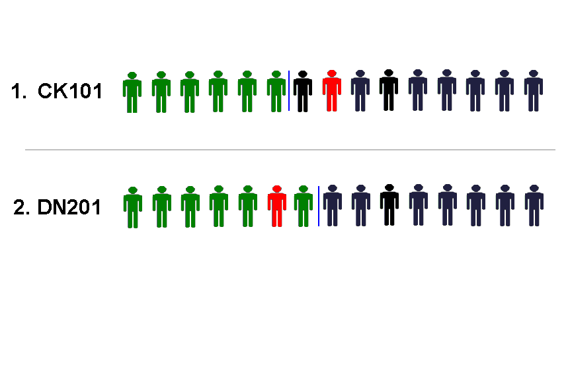
The applicant in red is offered her second preference, the highest preference course that she has enough points for, and she will now disappear from the queue in all of her lower choices. Placing DN201 as her second preference meant that she would prefer to receive an offer on DN201 than on any other course except CK101 - which is her first preference.

Slide 38
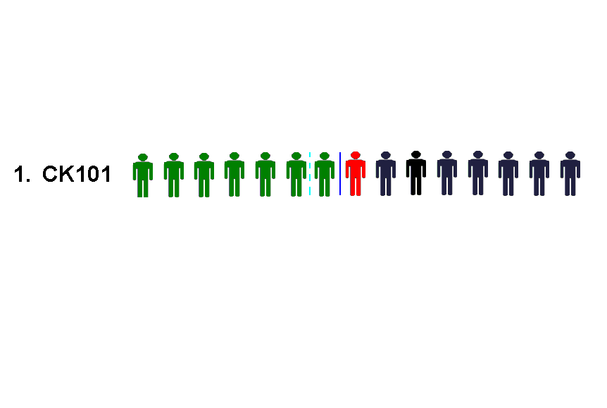
Having been offered her second preference she must now decide to accept it or to do nothing. If she does not accept the offer the place will be offered to another applicant in the next round of offers.
Regardless of whether she accepts or not she will still be considered for an offer on her first preference if a place becomes available. In second round offers, one more offer was made on CK101 and our applicant is now at the top of the queue.

Slide 39
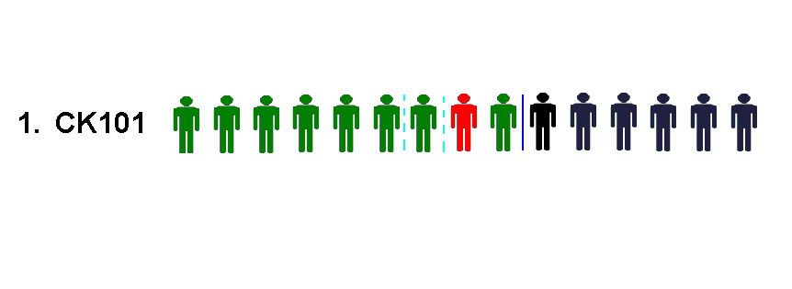
In the third round of offers two more offers are made on CK101 and our applicant, who was at the top of the queue, now receives an offer.
She may do nothing and remain in DN201 or she may accept the offer and begin in CK101.

Slide 40
Genuine Order of Preference
Try not to guess what the points are going to be for the courses you are interested in.
Simply list the courses in genuine order of preference from the highest preference 1, to the lowest preference 10.
If you are entitled to an offer, you will be offered the highest preference that you are entitled to.

Slide 41


Access Routes to College

Slide 42
DARE: Disability Access Route to College
Any student that has a specific learning difficulty/disability is encouraged to indicate this on their CAO form.
SIF: Supplementary Information Form
Section A: completed by student
Section B: completed by school
Section C: completed by consultant

Slide 43
Who is eligible to apply?
Financial Indicators Social &Cultural Indicators
1. Income 4. Socio-Economic Group
2. Medical Card 5. School (not applicable!)
3. Social Welfare Payment 6. Area
Applicants must meet the 1. Income plus 2 other indicators in order to be eligible.

Slide 44
No of dependent children in your family | HEAR income limit
Less than 4 | €45,790
4-7 | €50,325
More than 8 | €54,630
Add €4,670 to the total income for every parent/sibling enrolled in a full-time College, University or PLC course

Slide 45

Important Points
Read the CAO handbook and keep safe- may need to refer to it throughout year
Read the relevant college prospectus
Choose courses in Order of Preference and based on genuine career aspirations
Do not base choice on projected exam results or last year’s CAO points
Do not guess, assume or listen to rumours
Always check with CAO if in doubt- use contact us facility on CAO website

Slide 46




PLC’S
Post Leaving Cert Courses (QQI/FETAC Level 5)
No CAO points needed...most have an interview process
Separate application process to CAO...apply directly to course provider (from late Jan/ early Feb 2021)

Slide 47
Why choose a PLC?
A ‘Gap Year’ option- try something new/ different
To help decide between career areas...a ‘taster’ course
An alternative entry route to Higher Education
e.g. excellent progression route between LCFE and LIT!
20+ UL courses have FETAC places including Arts, Business, Psychology
The NUI’s have increased the number of their courses that now have FETAC links- check college admissions pages

Slide 48
Higher Education Links Scheme
HELS enables learners who have completed a FETAC Level 5 to apply for a place on a range of Level 6, 7 or 8 courses in 17 0f Ireland’s IT’s and Universities
Approximately 2,000 places are available on over 250 courses– some courses require you to have completed a specific PLC course e.g. Pre-Nursing Studies for Nursing Degrees
Students must apply as a FETAC candidate to CAO and they can get up to 400 FETAC points
Points are calculated on the eight modules taken and allocated approx. as follows- Pass: 20 pts Merit: 35 pts Distinction: 50 pts

Slide 49
Financial Support for Students
  Universal Grant Application System called SUSI
  (Student Universal Support Ireland)
  All details of how and what’s needed to apply are available on www.studentfinance.ie or www.susi.ie
  Apply early...exact opening date varies every year...usually late March/ early April...keep an eye on website
    If in doubt, check it out.

Slide 50
Alert Lists
Found on the CAO website -> student resources…
… new courses that may not be in the CAO Handbook may come on stream during the academic year
… OR any cancelled courses that will not run in 2021

